Slide 1
Environmental Compliance Assistance for Business & Industry Energy Conservation
Steven Kessler
Director, aero Facilities & Maintenance for the Americas

Slide 2
Steven Kessler Director, Facilities & Maintenance for the Americas
Background: Adjunct Professor – PVCC (Business Concentration)
School: Purdue University – BS: Industrial Engineering Technology, Keller Graduate School of Management – MBA: Information Systems Management/Healthcare, Grand Canyon University – Doctorate: Business Administration/Management (2/2020)
Certifications: RCGC – AGA/IGT
Previous Experience: Logistics/Shipping, ESCO, Controls, Construction, Dual Fuel Investor Utility
Years with HON: 9 Months

Slide 3
Goals & Objectives
How critical is sustainability?
Understanding Common Terms.
Quick Reference Notes.
What can we all do to save energy.
What is PF (Power Factor).
What Honeywell has accomplished – We're not done yet.
Smart Buildings

Slide 4
Sustainability – Definition
“Sustainable development is
development that meets the
needs of the present without
compromising the ability
of future generations to
meet their own needs.”
Brundtland World Commission on
Environment and Development definition
An Objective Without a Plan is Just a Wish

Slide 5
Biggest Concerns
93% - Climate Change
91% - Education
83% - Income Equality
82% - Immigration
75% - Reproductive Rights
69% - Trade
Fast Company – Nov. 2019
People Surveyed with Greatest Concerns/Impacts

Slide 6
Key Concepts
BTU: One British Thermal Unit (BTU) represents the amount of heat that is required to raise or lower the temperature of 1 pound of water by 1 degree Fahrenheit. Most air conditioners are measured using BTUs.
BTUh: Some systems measure their energy by British Thermal Units per Hour (BTUh). The energy that is extracted from your home by an air conditioner is measured in BTUs, while the cooling and heating capacities are referred to in BTUh. For reference, 12,000 BTUh is equal to 1 ton of cooling.
EER: Energy Efficiency Ratio (EER) of a cooling unit is determined by the output cooling divided by the electrical power input. As opposed to Seasonal Energy Efficiency Ratio (SEER), which is calculated over a range of outside temperatures, EER is typically determined by a set outside air temperature, a set inside air temperature and 50 percent relative humidity. For reference, 11 EER is roughly 12 SEER.
Level setting with key terms

Slide 7
Key Concepts
HSPF: The Heating Seasonal Performance Factor (HSPF) is used to measure the efficiency of a heat pump. The HSPF is a ratio of the heat output to electricity use over an average heating season. The higher the HSPF, the greater the energy efficiency.
SEER: Seasonal Energy Efficiency Ratio (SEER) measures air conditioning and heat pump cooling efficiency, which is calculated by the cooling output for a typical cooling season divided by the total electrical energy input during the same time frame. The higher the SEER rating, the greater the energy efficiency, and, in turn, the lower your energy cost.
Level setting with key terms

Slide 8
Key Concepts - HVAC
Air Movement 6 ACH or 1 CFM/ft2
Ventilation Rate 5 CFM/person
Lighting T12s: 1.2 W/SQFT, T8s: 0.8 W/SQFT
LEDs: 0.4 W/SQFT
LEDs use 50% of CFLs
Chiller Size 300-600 ft2/ton, Ton 12,000 BTU/ton
People Load 450 BTU/person/hr.
People Density Office 140 ft2/person
Theater 14 ft2/person
Level setting with key terms

Slide 9
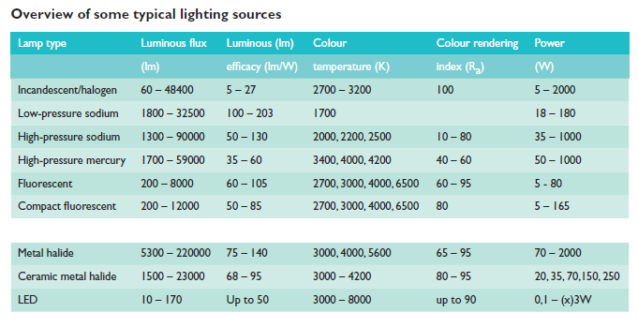
Key Concepts – Lighting
Level setting with key terms

Slide 10
Power Factor – Simplified
Understanding PF%

Slide 11
Power Factor – Simplified
Poor power factor means that you’re using power inefficiently. This matters to companies because it can result in:
Heat damage to insulation and other circuit components
Reduction in the amount of available useful power
A required increase in conductor and equipment sizes
Finally, power factor increases the overall cost of a power distribution system because the lower power factor requires a higher current to supply the loads.
Understanding PF%

Slide 12
Executive summary
Honeywell AERO operates 11 major office/engineering and manufacturing sites in Arizona
From 2016 to 2018 Honeywell AERO sites in Arizona completed 431 energy and water saving projects
Carbon savings of 26,517,937 lbs. per year
Energy savings of 87,152,712 Kbtu per year
Water savings of 9,903,839 gallons per year
Costs savings of $2.56M per year
Investment of $ 6.52M

Slide 13
Lighting projects
240 projects – convert HID and fluorescent lighting to LED including building exterior, offices lighting and production area lighting
14,672,881 kbtu energy savings
Top Sites and Projects
Glendale – 27 LED retrofit projects
Sky Harbor – 10 LED retrofit projects
Phoenix – 91 LED retrofit projects
Tempe – 24 LED retrofit projects
Deer Valley – 26 LED retrofit projects
Tucson – 36 LED retrofit projects

Slide 14
Cooling plant/systems projects
12 projects
20,917,991 kbtu energy savings
Top Sites and Projects
Deer Valley – Replacement of 2 Central Plant chillers
Phoenix – Replacement of 1 Central Plant chiller
Sky Harbor – Replacement of 3 Central Plant chillers
Tucson – Replacement of 3 Central Plant cooling towers
Phoenix – Replacement of 6 Evaporative coolers

Slide 15
Compressed air projects
23 projects
23,273,529 kbtu energy savings
Top Projects
9 sites conduct ultrasonic compressed air leak surveys – 21 surveys completed
Deer Valley – replace fixed speed air compressor with variable speed drive air compressor

Slide 16
Water savings projects
29 projects
9,903,839 gallons water savings
Top Projects
Tucson - Install make-up water conductivity meters on cooling towers
Tempe – Install new dishwasher and water saving restroom fixtures
Phoenix – Xeriscaping and water saving restroom fixtures
Sky Harbor – Xeriscaping and water saving restroom fixtures

Slide 17
HVAC and control systems projects
59 projects including installation of programmable thermostats, building automation system enhancements, variable speed drives on air handling units, high efficiency boilers, high efficiency motors, economiser control programs, chiller optimization control system, and setpoint/schedule optimization
20,743,389 kbtu energy savings
Top Projects
Tucson - Replace boilers with high efficiency boilers
Tempe – Building Automation System program and controls upgrades
Phoenix – Setpoint/Schedule optimization, programmable thermostats
Sky Harbor – Install central plant chilled water optimization system
Deer Valley – Variable speed drives on cooling towers

Slide 18
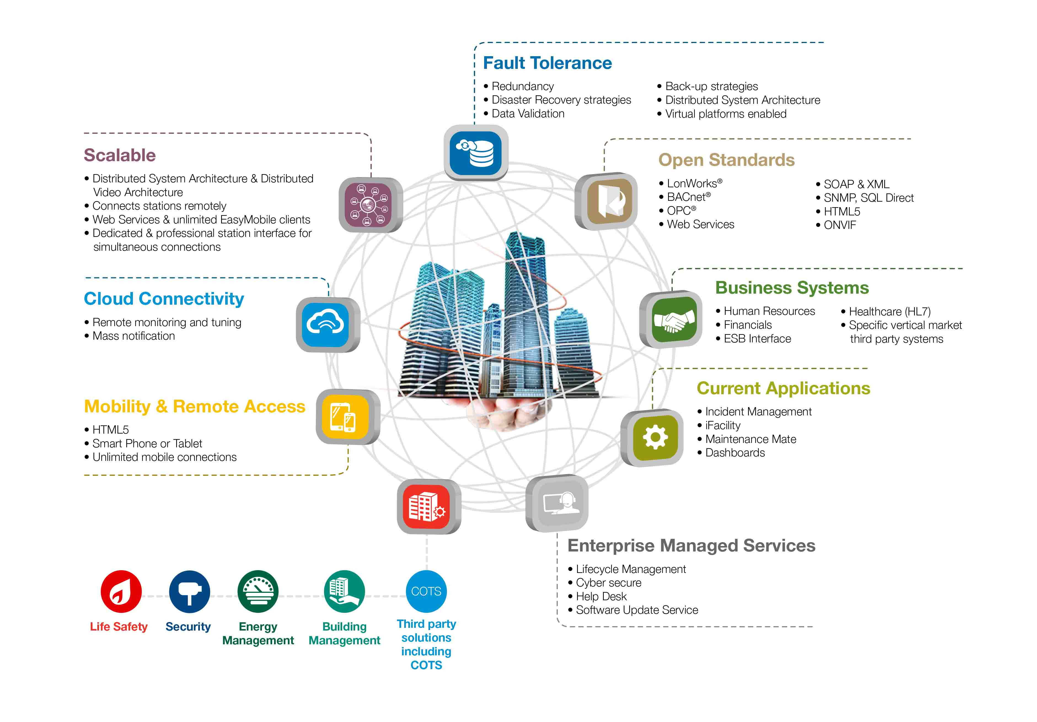
Smart Building Solutions
Enterprise Buildings Integrator (EBI)

Slide 19
THANK YOU
Contact information
Email: Steven.Kessler@Honeywell.com
Phone: 602.245.4080
Questions?
HSEF: Safe & Sustainable
We Shape the Future of a Smarter, Safer, and more Sustainable World
Notes:
Closing slide

